Slide 1

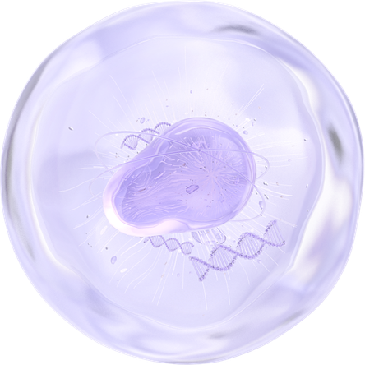
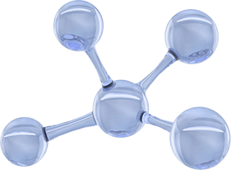
ALZHEIMER'S DISEASE PREDICTION USING RNA-SEQ GENE EXPRESSION DATA AND MACHINE LEARNING
Final Project — CBIO313: Data Mining and Machine Learning
Prepared by: Jessica Amgad Anis | ID: 231001218

Slide 2
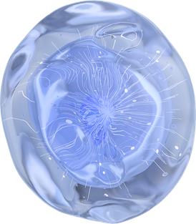
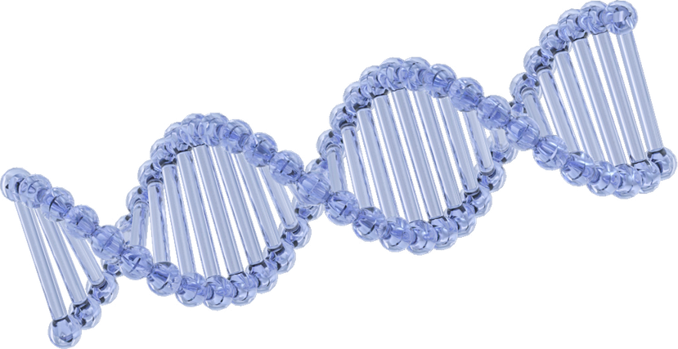
Introduction
Introduction
Alzheimer’s disease (AD) is a progressive neurological disorder that affects:
Memory
Cognitive abilities
Daily functioning
?
Early prediction of Alzheimer’s disease is important because it can:
Support medical research
Improve diagnosis
Assist in early intervention
?
Gene expression analysis using RNA-Seq data provides biological insights into disease mechanisms.
Machine learning can identify hidden patterns in high-dimensional biological datasets.
?

Slide 3

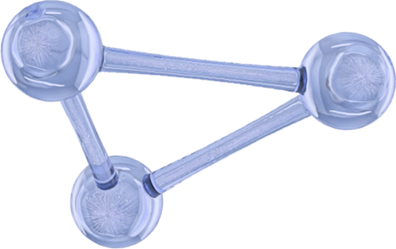
Project Objective
Project Objective
The objective of this project is to:
Develop a machine learning model capable of distinguishing:
Alzheimer’s disease samples
Non-Alzheimer’s control samples
Use RNA-Seq gene expression data for classification.
Apply a complete machine learning workflow including:
Data preprocessing
Exploratory data analysis
Feature engineering
Feature selection
Model training
Hyperparameter tuning
Model evaluation
Web deployment

Slide 4
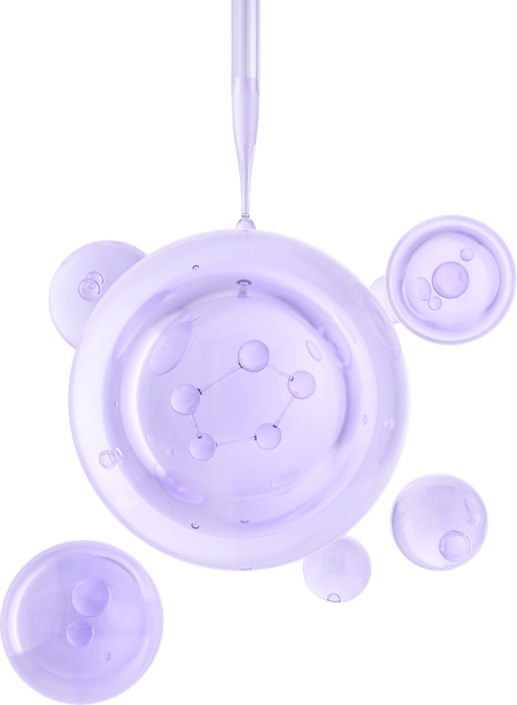

Problem Statement
Problem Statement
Alzheimer’s disease diagnosis remains challenging.
Biological datasets contain complex and high-dimensional information.
Traditional analysis methods may fail to detect subtle gene expression patterns.
Goal:
Build a predictive machine learning model using RNA-Seq gene expression data to classify:
AD samples → Class 1
Control samples → Class 0

Slide 5
Dataset Description
Dataset Characteristics
RNA-Seq gene expression dataset
Genes originally represented as rows
Samples represented as columns
Sample Groups
Alzheimer’s Disease (AD)
Old Controls
Young Controls
Dataset Transformation
Dataset transposed for machine learning compatibility
Samples became rows
Genes became columns
Binary Classification
AD samples labeled as 1
Control samples labeled as 0

Slide 6



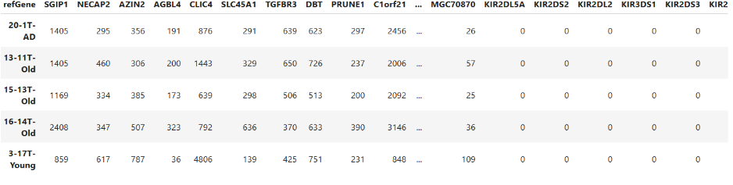
Dataset Size and Challenges
Dataset Size
30 biological samples
More than 27,000 gene expression features
Challenges
High dimensionality
Small sample size
Risk of overfitting
Computational complexity
importance of Preprocessing
Remove noise
Improve efficiency
Increase model reliability

Slide 7
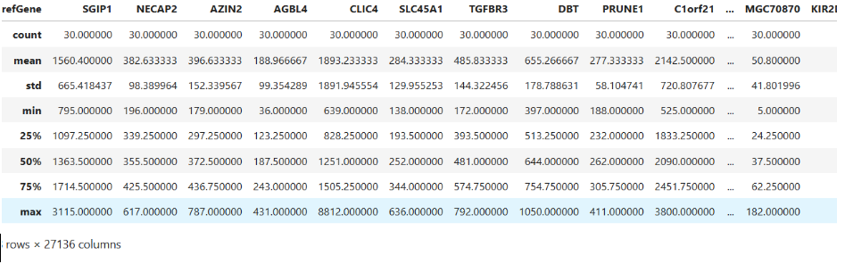
Data Cleaning and Preprocessing
Initial Inspection Included
Missing value detection
Duplicate checking
Data type validation
Summary statistics review
Additional Preprocessing
Removed constant (zero-variance) genes
Applied feature scaling for machine learning algorithms
1
3
Observations
RNA-Seq data showed strong right-skewed distribution
Many genes had low expression
Few genes had extremely high counts
2

Slide 8

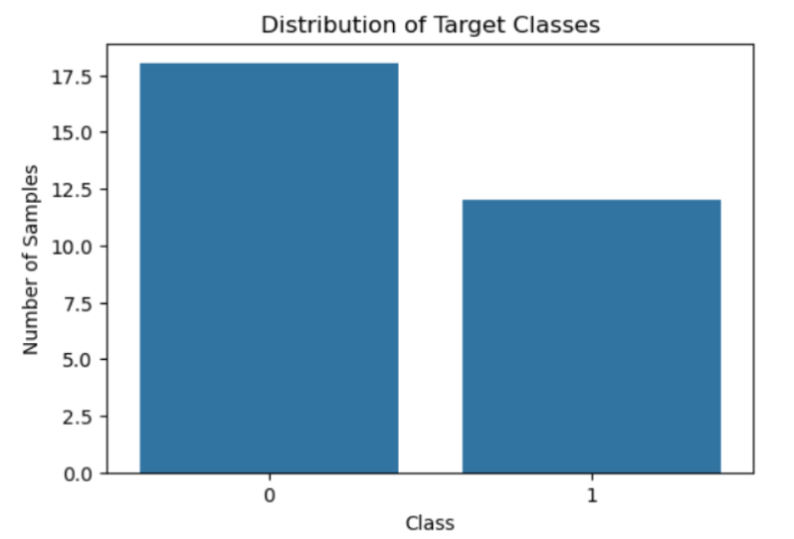
Target Variable Distribution
Class Distribution
Dataset Distribution
18 Control samples
12 Alzheimer’s samples
Observations
Dataset is slightly imbalanced
Not severely imbalanced
Both classes sufficiently represented
Importance
Balanced datasets help:
Improve learning quality
Reduce prediction bias
Improve evaluation reliability

Slide 9
Exploratory Data Analysis (EDA)
Exploratory Data Analysis (EDA)
Purpose of EDA
Understand gene expression behavior
Explore biological patterns
Identify possible disease-related genes
Selected Genes
SGIP1
ERI3-IT1
IDH2
ACOX1
CLIC4
CAMTA1
Analysis Types
Univariate analysis
Bivariate analysis
Correlation analysis

Slide 10
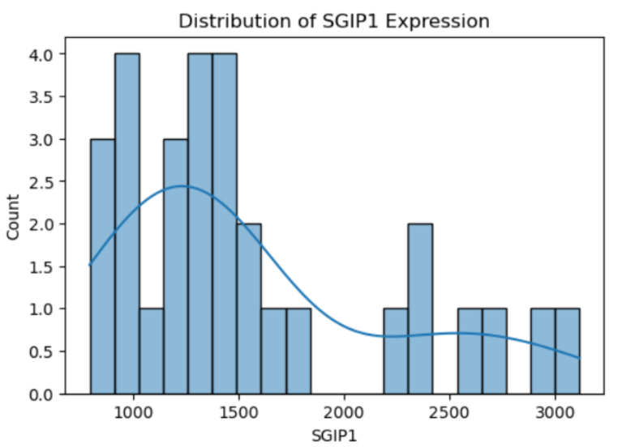
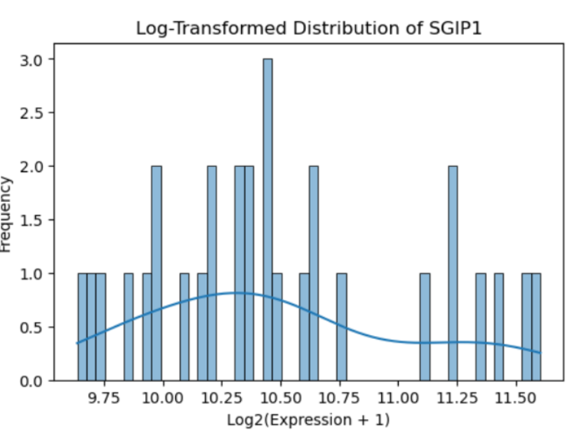
After applying:
log⁡2(x+1)\log_2(x+1)log2​(x+1)
Distribution became more symmetric.
Skewness was reduced.
Visualization improved significantly.
Benefits
Better statistical interpretation
Better ML compatibility
Reduced influence of extreme values
Interpretation
Distribution is strongly right-skewed.
Most samples show low expression values.
Few samples show extremely high expression.

Slide 11
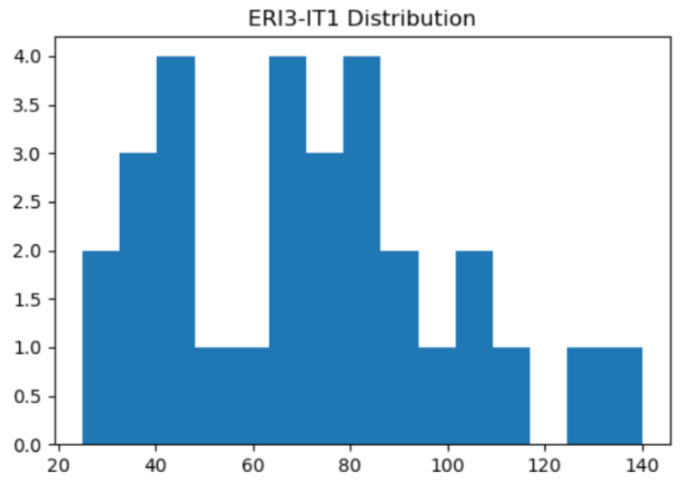
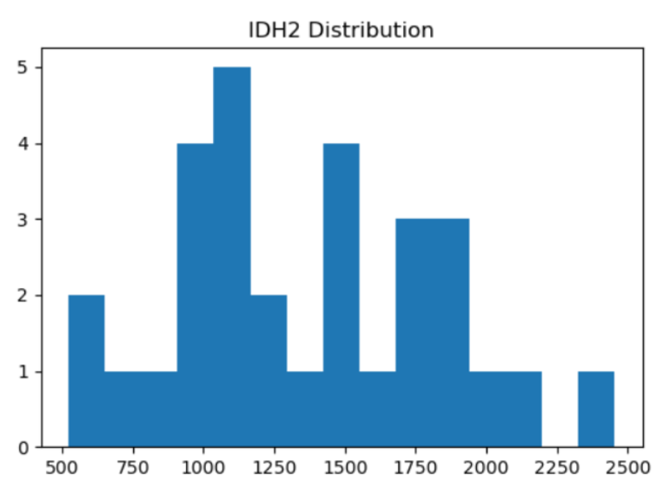
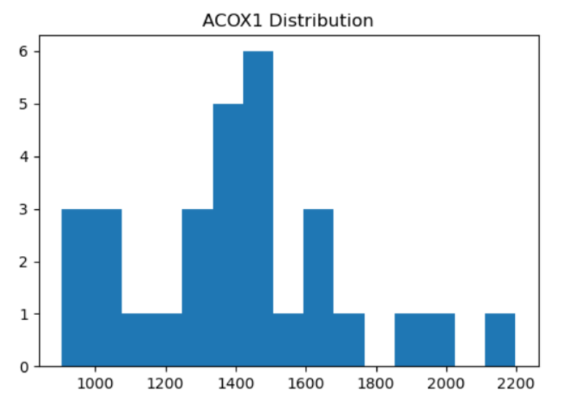
Most samples show near-zero expression.
Few samples exhibit elevated values.
Moderate spread across samples
Some variability between groups
Right-skewed distribution observed
Strong variability across samples

Slide 12
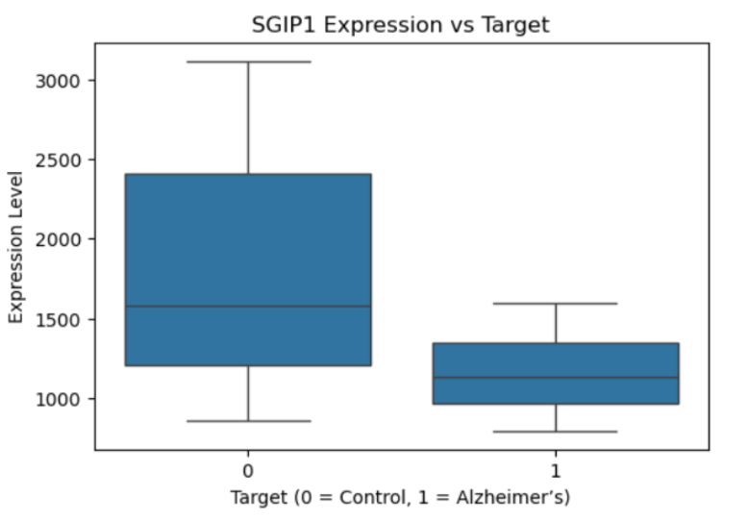
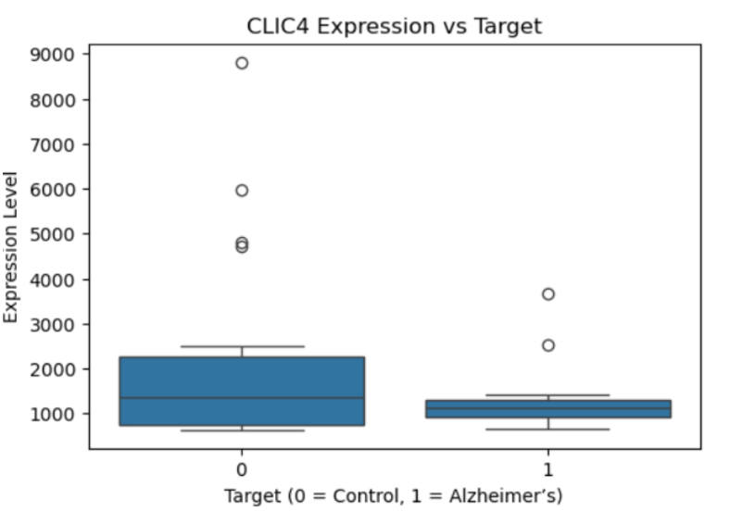
Bivariate Analysis
Study relationships between:
Gene expression levels
Disease classes
Stronger separation between classes
Possible upregulation in AD
Distribution shift between AD and control

Slide 13
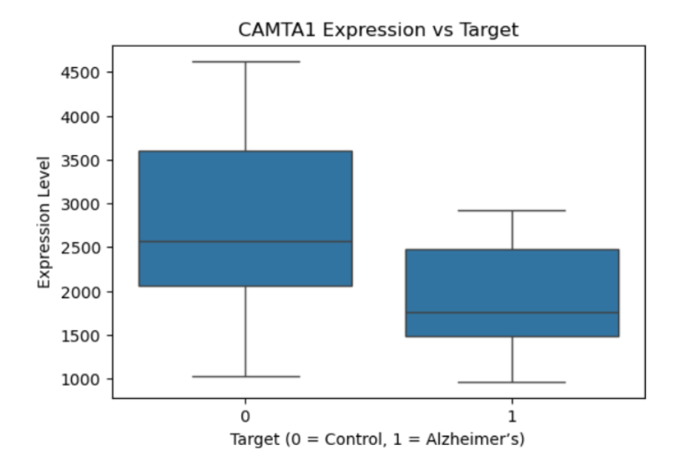
Bivariate Analysis
greater variability in AD samples

Slide 14
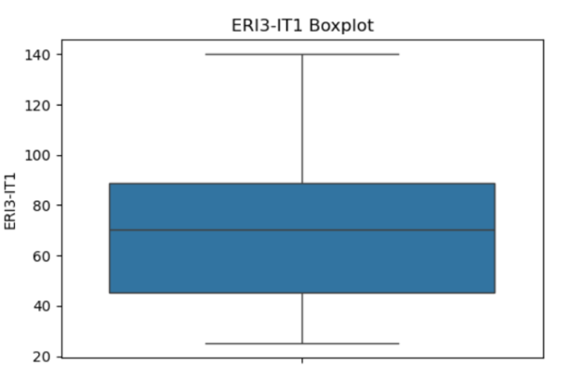
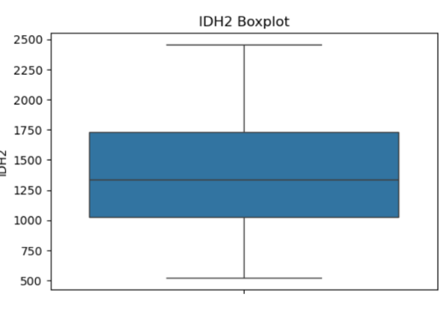
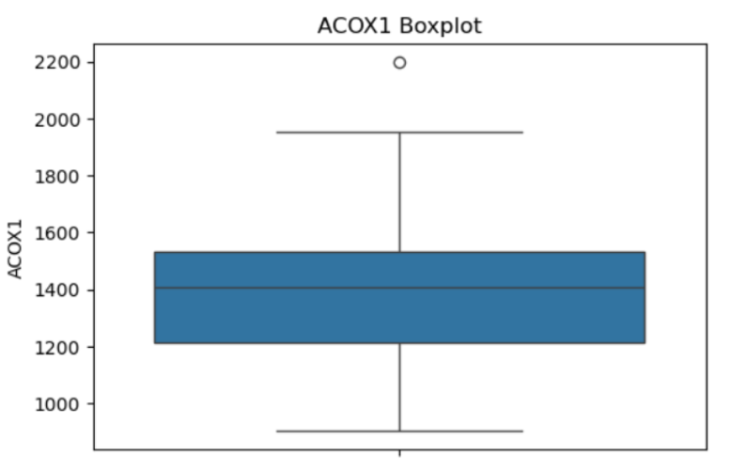
These boxplots show the spread and outliers for each gene across all samples. Genes with wide interquartile ranges (IQR) and many outlier points contain high variability — which is informative for classification. Genes with a tight IQR and few outliers are more uniformly expressed and may be less useful as features.

Slide 15
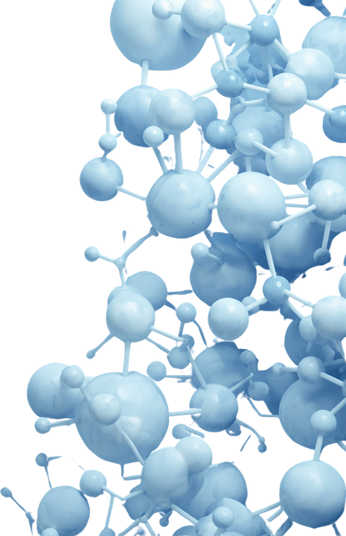
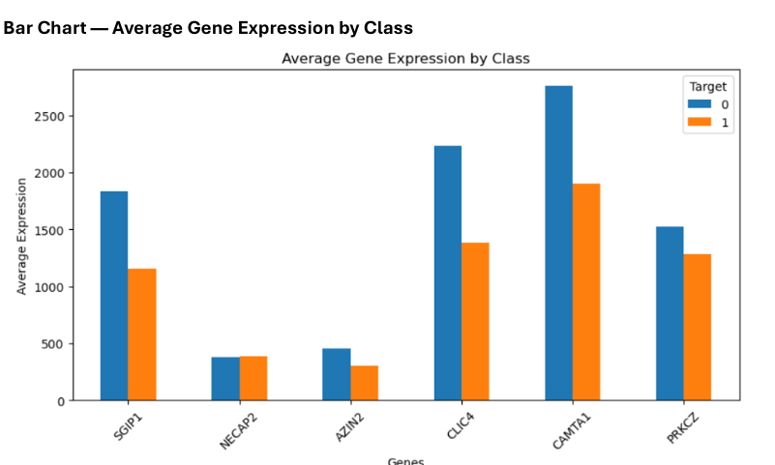


Slide 16
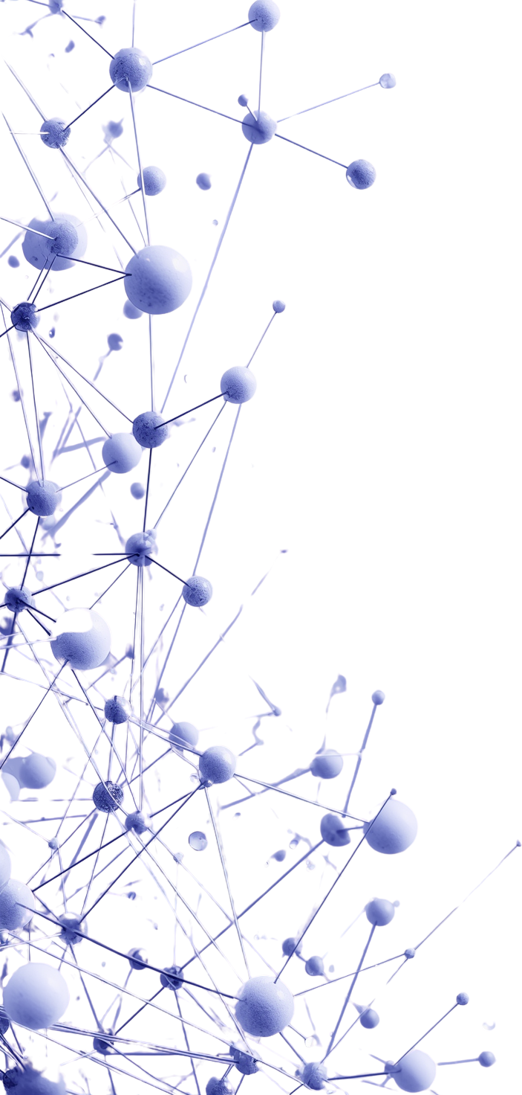
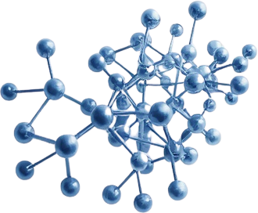
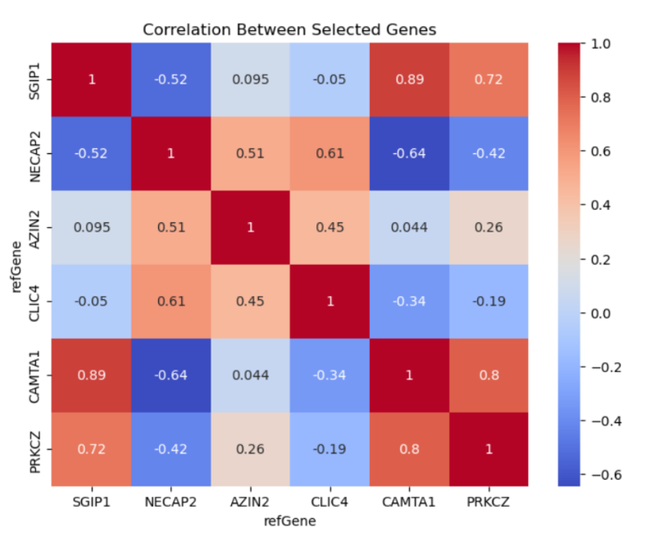
Correlation & Scatterplot Analysis
CORRELATION HEATMAP
Most genes showed weak to moderate correlation
Indicates diverse biological signals
Reduces redundancy in features
Scatterplot Findings
Gene pairs:
SGIP1 vs CLIC4
ERI3-IT1 vs IDH2
ACOX1 vs SGIP1
showed partial class separation.
Conclusion
Single genes alone are insufficient.
Multi-feature models are necessary.

Slide 17
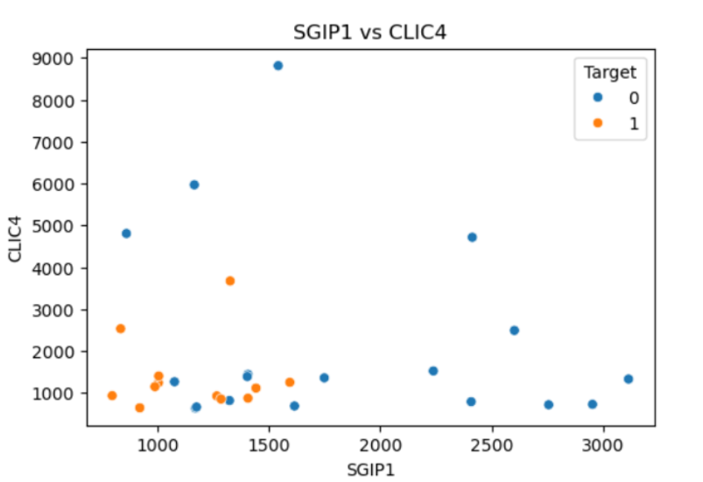
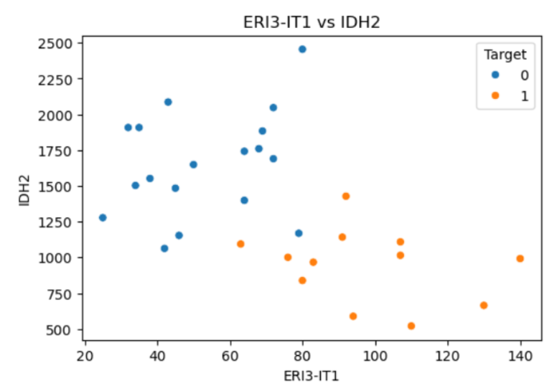

Slide 18
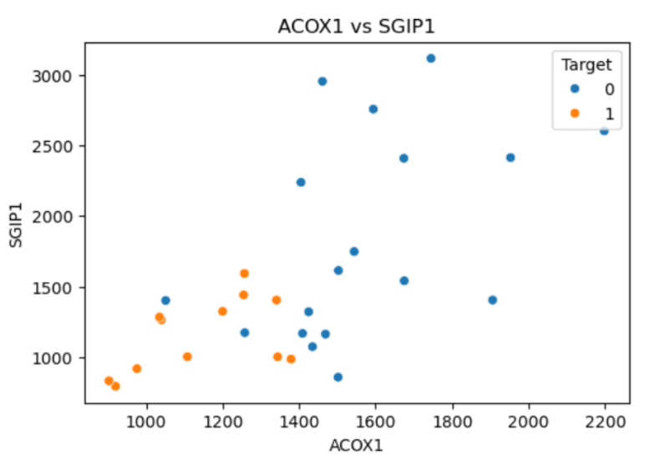
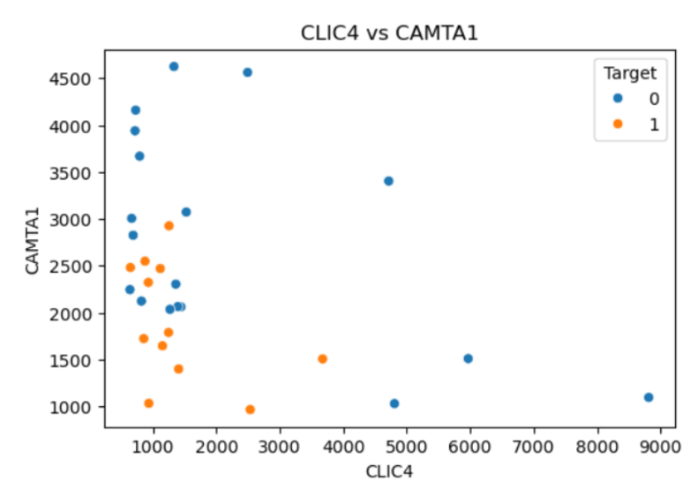
The pairwise scatter plots show how effectively gene pairs distinguish between the two classes. Gene pairs forming clear separate clusters are strong features for classification, while overlapping patterns indicate weaker discrimination and the need for additional features or more complex models.

Slide 19
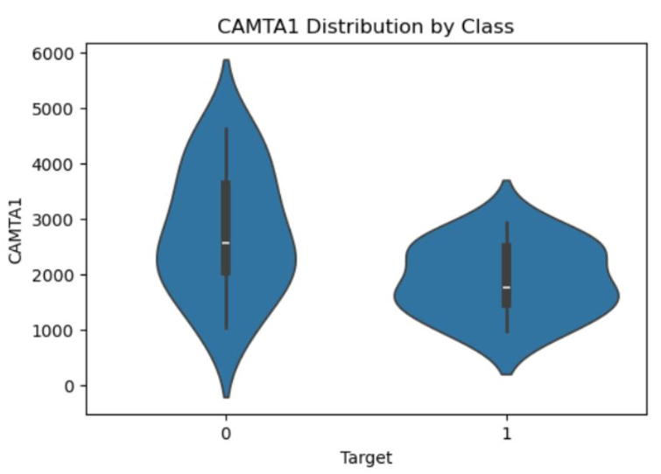
Violin plot — CAMTA1 by Class
The violin plot shows the distribution of CAMTA1 expression across both classes. Wider sections represent higher sample density at specific expression levels, helping visualize distribution patterns and variability. Differences in distribution shape or shifts between class 0 and class 1 support CAMTA1 as an important predictive feature.

Slide 20
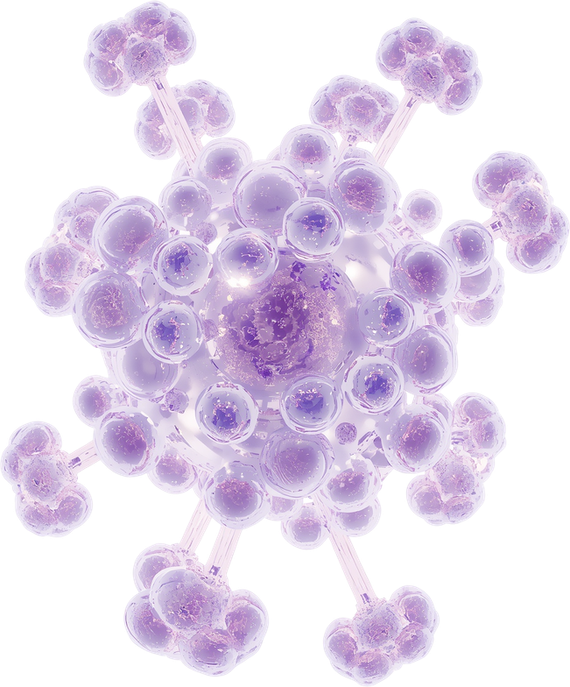

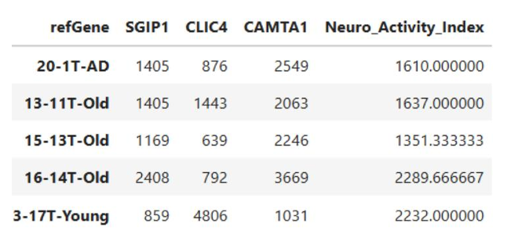
Feature Engineering
Feature Engineering
Created Feature:
Neuro Activity Index
Formula
Average expression of:
SGIP1
CLIC4
CAMTA1
Purpose
Combine multiple biological signals into one feature to:
Capture neurological activity patterns
Improve disease discrimination

Slide 21
Feature Selection
Feature Selection
Why Feature Selection?
Using all 25,000+ genes may cause:
Overfitting
High computational cost
Reduced interpretability
Method Used
SelectKBest
ANOVA F-test
Goal
Select the most informative genes associated with Alzheimer’s disease.

Slide 22
Top Selected Features
Selected Features
Top 10 Features
ERI3-IT1
DPH2
LHX4-AS1
MBNL1-AS1
LOC101926975
DNAH11
RABGEF1
ZNF596
ZNF449
CCDC144CP
Top 3 Features
ERI3-IT1
DPH2
LHX4-AS1
Importance
These genes provided the strongest classification signal.

Slide 23
Validation Strategy
Machine Learning Models
Models Evaluated
Logistic Regression
Decision Tree
Random Forest
Data Splitting
80% Training
20% Testing
Stratified Splitting
Maintained class proportions in:
Training set
Testing set
Validation and Generalization
Validation Techniques Used
Train-test split
Cross-validation
Why Validation Matters
Prevents:
Overfitting
Memorization of training data
Ensures:
Reliable performance
Better generalization to unseen data
Importance in Bioinformatics
Especially critical because:
Feature count is extremely high
Sample count is limited

Slide 24
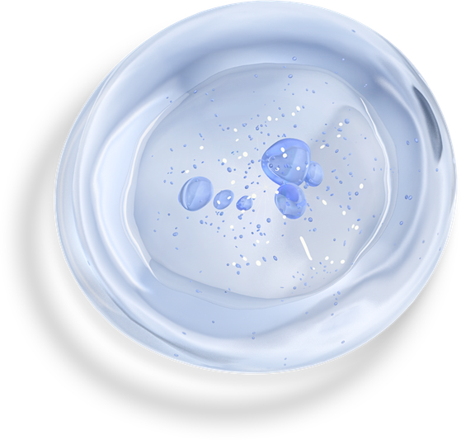

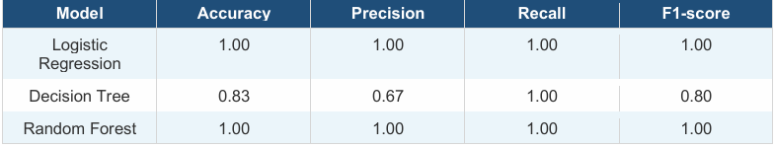
Model Comparison Results
INTERPRETATION
RANDOM FOREST AND LOGISTIC REGRESSION PERFORMED BEST
DECISION TREE PRODUCED FALSE POSITIVES
RANDOM FOREST SELECTED AS FINAL MODEL

Slide 25


Confusion Matrix
Confusion Matrix Analysis
Confusion Matrix Components
True Positives
True Negatives
False Positives
False Negatives
Observation
The final Random Forest model showed:
Perfect diagonal classification
Zero off-diagonal errors
Conclusion
Excellent separation between AD and control samples.

Slide 26
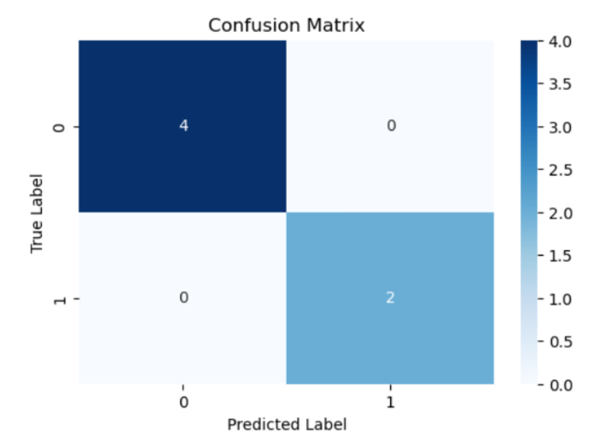
he confusion matrix shows: •
True Negatives (top-left): Control samples correctly predicted as control •
True Positives (bottom-right): AD samples correctly predicted as AD •
False Positives (top-right): Control samples incorrectly predicted as AD •
False Negatives (bottom-left): AD samples incorrectly predicted as control

Slide 27

Hyperparameter Tuning
Technique Used
GridSearchCV
Purpose
Find optimal Random Forest parameters:
Number of trees
Tree depth
Minimum split size
Process
8 parameter combinations tested
5-fold cross-validation applied
Benefit
Improved:
Generalization
Robustness
Reliability

Slide 28
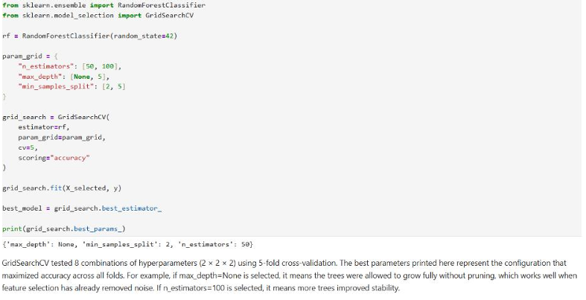
Hyperparameter Tuning

Slide 29
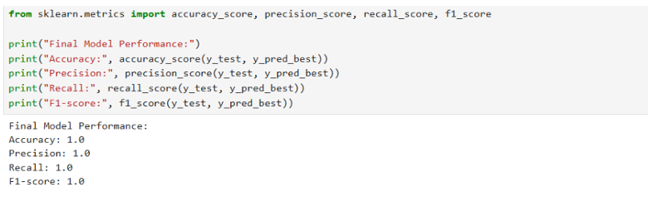
Results of Hyperparameter Tuning
The tuned Random Forest achieved the same perfect scores as the baseline model on this small test set. While this indicates strong class separability in the selected features, it also reflects the very small test size (6 samples at 80/20 split). Results should be interpreted cautiously — future work should use cross-validation scores as the primary performance estimate rather than a single holdout split.

Slide 30
Feature Importance Analysis
Feature Importance Using Random Forest
Purpose
Identify genes contributing most to classification.
Top Important Genes
DPH2
ZNF449
RABGEF1
Importance of Feature Importance
Reduces model complexity
Improves interpretability
Identifies potential biomarkers

Slide 31
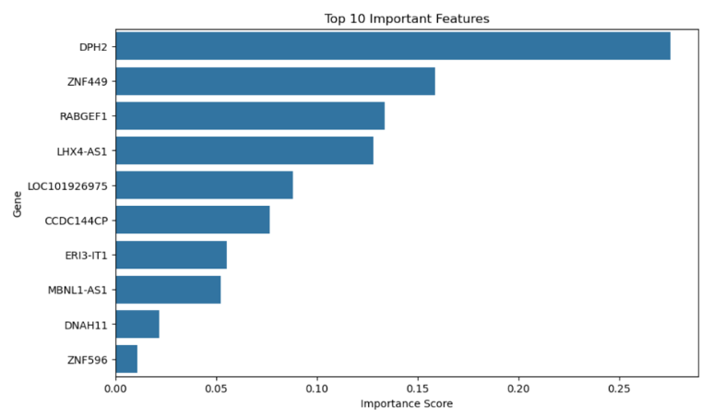
Visualization of Top Important Features

Slide 32
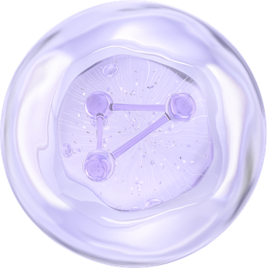
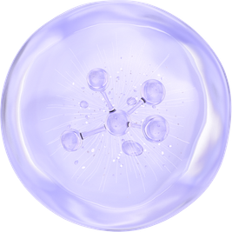
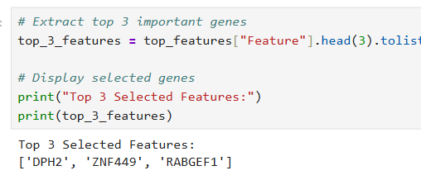
Simplified Deployment Model
Strategy
Used only top 3 most important genes to create:
Lightweight model
Faster deployment system
Benefits
Simpler interface
Reduced computation
Comparable performance to full model
Result
Strong predictive ability maintained with only 3 genes.

Slide 33
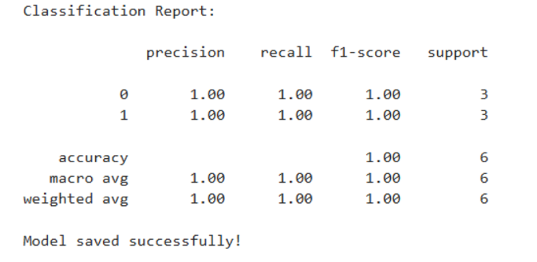
Final Model Performance
Notes
High performance due to:
Strong biological signal
Effective feature selection
Ensemble learning capability
Limitation
Small dataset size may inflate performance estimates.

Slide 34
Model Saving & Requirements
Model Saving and Reproducibility
Model Saving
Deployment model saved using Joblib
Advantages
Avoids retraining
Faster deployment
Easier reuse
Requirements File
requirements.txt created to:
Store dependencies
Reproduce environment
Simplify deployment

Slide 35



Web Application Deployment
Flask Backend
Powers the prediction engine. Handles model loading, processes gene expression inputs, and serves prediction routes via a lightweight REST API.
Streamlit Frontend
Deployed on Streamlit Community Cloud. Provides an interactive browser-based interface for users to input gene expression values seamlessly.
Real-Time Prediction
Users input gene expression values and instantly receive Alzheimer's vs. control classification results powered by the trained Random Forest model.
Deployment Included
Model loading
HTML/Streamlit interface
Prediction routes
Real-time prediction

Slide 36




Deployment Process
STEP 1
STEP 2
STEP 3
STEP 4
Create a Streamlit Cloud account at streamlit.io/cloud. Sign up using your GitHub credentials for seamless integration and access to deployment features.
Link your GitHub repository. Select the target branch and specify app.py as the entry point. Streamlit reads your project structure automatically.
Streamlit automatically installs all required dependencies from requirements.txt. Ensure all libraries are listed: Streamlit, NumPy, Pandas, Scikit-learn, and Joblib.
The app is launched publicly and becomes accessible via a unique Streamlit URL. Users can immediately interact with the Alzheimer's prediction interface in their browser.
The Streamlit Community Cloud platform enables rapid, free deployment directly from a GitHub repository. The entire workflow — from account creation to a live public application — requires no server configuration, making it ideal for academic and research-oriented machine learning projects. Required libraries: Streamlit, NumPy, Pandas, Scikit-learn, Joblib.

Slide 37
Deployment Challenges
Missing packages and incorrect dependencies caused deployment failures. Python version conflicts between local and cloud environments led to incompatible library installations, breaking the app on launch.
1
Git authentication problems prevented repository linking, while incorrect deployment paths caused Streamlit to fail locating app.py and required configuration files.
2
Solutions: updated requirements.txt with pinned library versions, resolved Python version mismatches, installed and configured Git credentials, and corrected Streamlit configuration paths to ensure successful public deployment.
3

Slide 38
Final Deployment Outcome
DEPLOYMENT SUCCESS
The Alzheimer's prediction app was successfully deployed and is publicly accessible via Streamlit Community Cloud. The application is fully operational, allowing real-time classification of Alzheimer's vs. control samples based on RNA-Seq gene expression input.
USER CAPABILITIES & ADVANTAGES
Users can input gene expression values and receive instant AD predictions through an interactive browser interface. Key advantages include easy deployment, free hosting, seamless GitHub integration, and no local installation required — making the tool accessible for research and educational use.

Slide 39
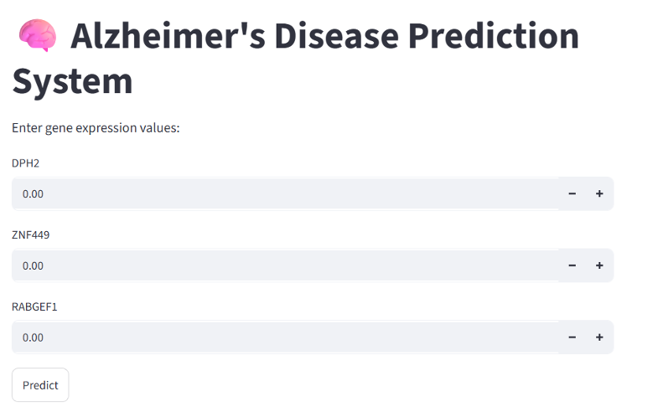
Final Deployment Outcome
After resolving all dependency and configuration issues, the application was successfully deployed and became publicly accessible through a Streamlit web link. Users can interact with the system through a browser interface, input patient data, and receive Alzheimer disease predictions generated by the trained machine learning model.

Slide 40
Conclusion
Successfully predicted Alzheimer's Disease using RNA-Seq gene expression data and a complete machine learning workflow — from preprocessing and EDA through feature selection, modeling, and evaluation.
?
Dimensionality reduction (from 27,136 to 25,379 features) and SelectKBest feature selection proved highly effective in managing high-dimensional data, reducing noise, and improving model interpretability.
?
Random Forest emerged as the best-performing classifier with perfect metrics (Accuracy, Precision, Recall, F1 = 1.00), and the final model was successfully deployed as a publicly accessible web application via Streamlit.
?

Slide 41
Future Work
Use larger, more diverse RNA-Seq datasets to improve model generalizability. Apply deep learning methods such as CNNs or autoencoders to capture complex gene expression patterns beyond traditional ML approaches.
1
Validate the model on external, independent datasets to confirm robustness. Integrate multi-omics data — including proteomics and epigenomics — alongside RNA-Seq to enrich biological signal and prediction accuracy.
2
Improve clinical applicability by refining the deployment interface for real-world diagnostic use. Develop more sophisticated and scalable platforms that bridge computational research with practical clinical decision support.
3

Slide 42
THANK
YOU
Questions & Discussion | Jessica Amgad Anis | CBIO313: Data Mining and Machine Learning

